Slide 1

A day at the GYM

Slide 2
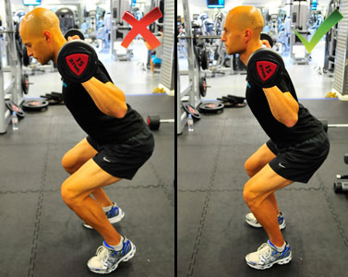
Mistakes

Slide 3

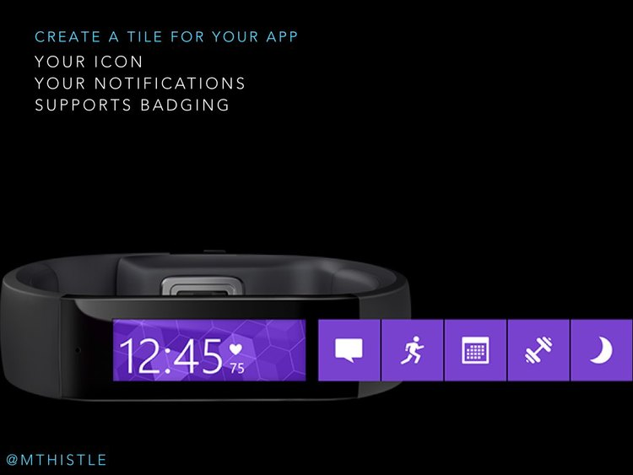

Detecting Unseen Anomalies in Weights Training Exercises
Yousef Kowsar, Masud Moshtaghi, Eduardo Velloso, Lars Kulik, Christopher Leckie
y.Kowsar@student.unimelb.edu.au

Slide 4

Beginners

Slide 5
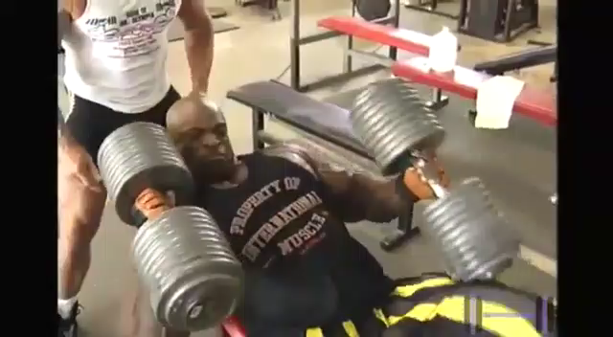
Professionals

Slide 6
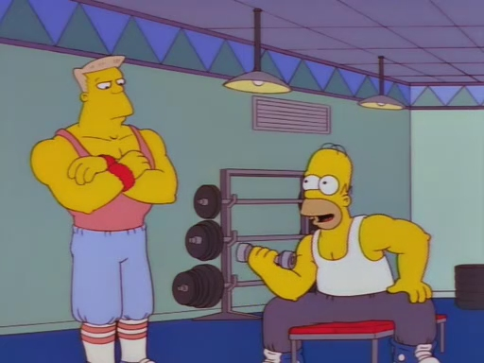
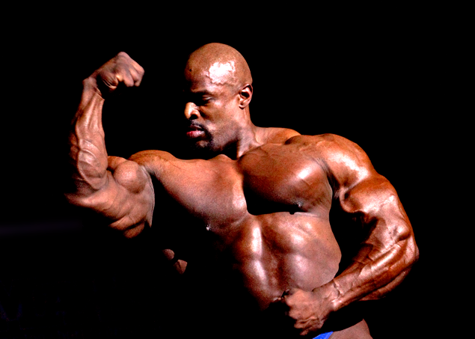
Learn from the correct performance
Homer can learn from personal trainer
The system can learn from low weight exercise of Ronnie

Slide 7
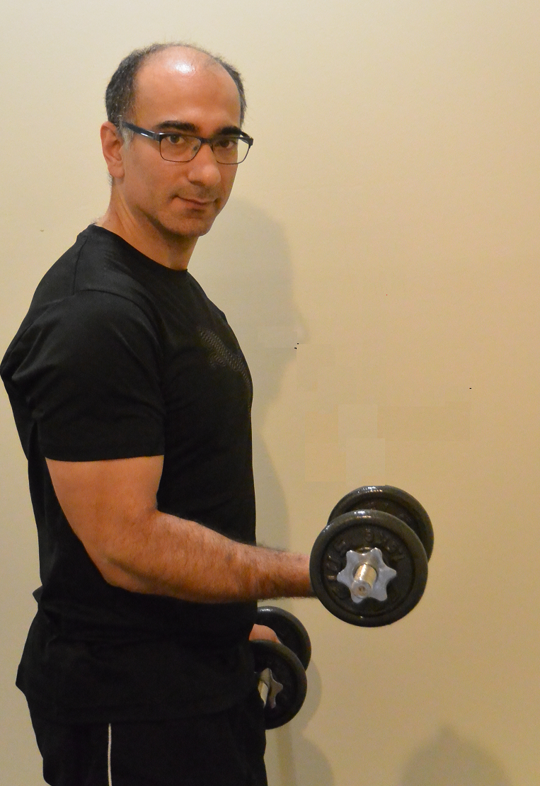
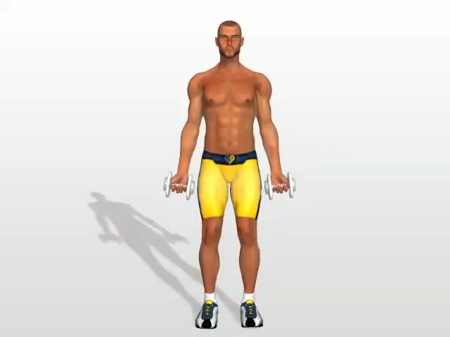
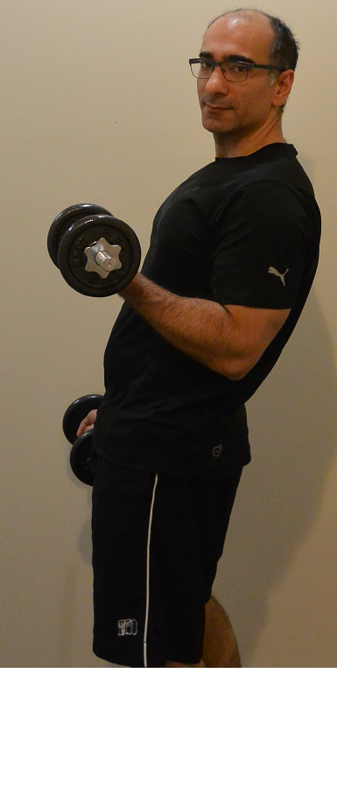
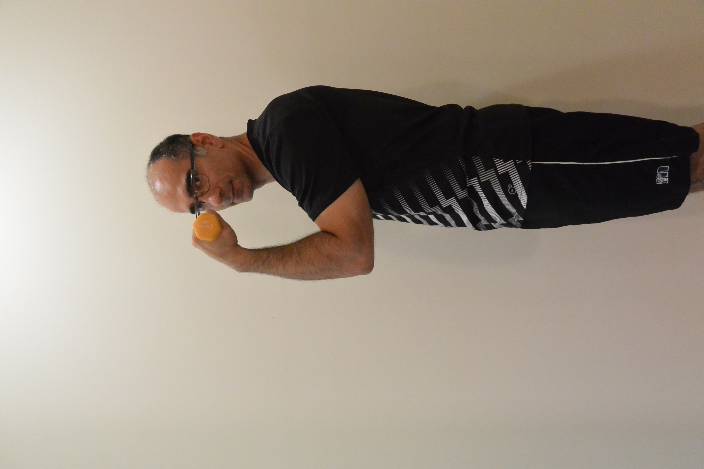

Slide 8
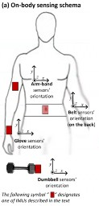
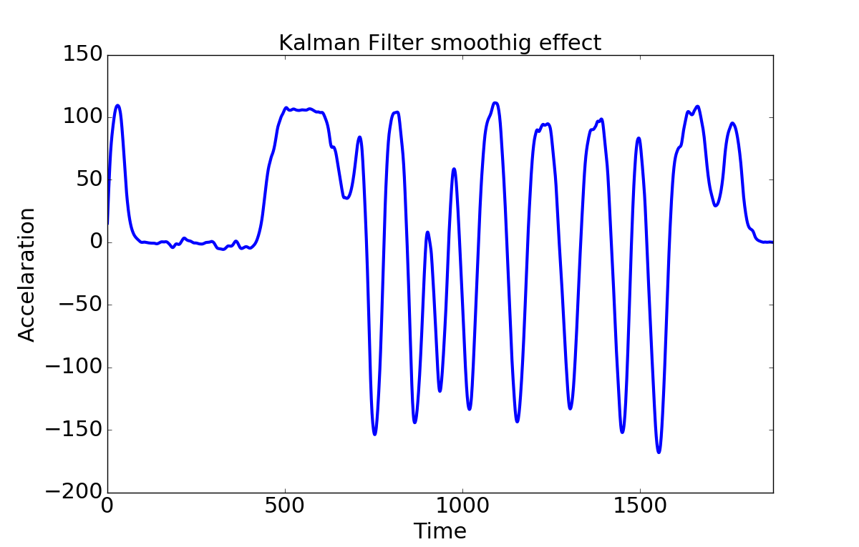
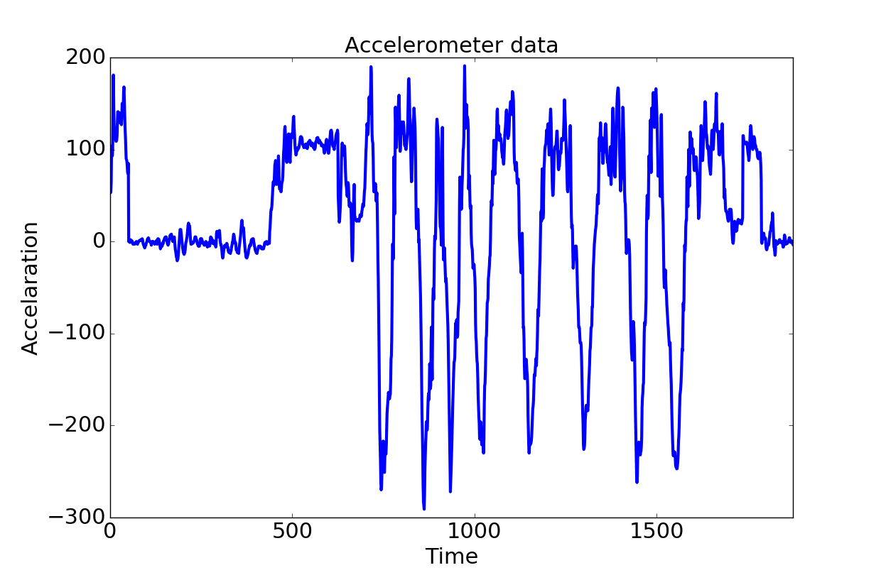
Workflow
New performance
WORKFLOW
Analyse
Learn
.

Slide 9
Step 1: Removing noise
WORKFLOW

Slide 10
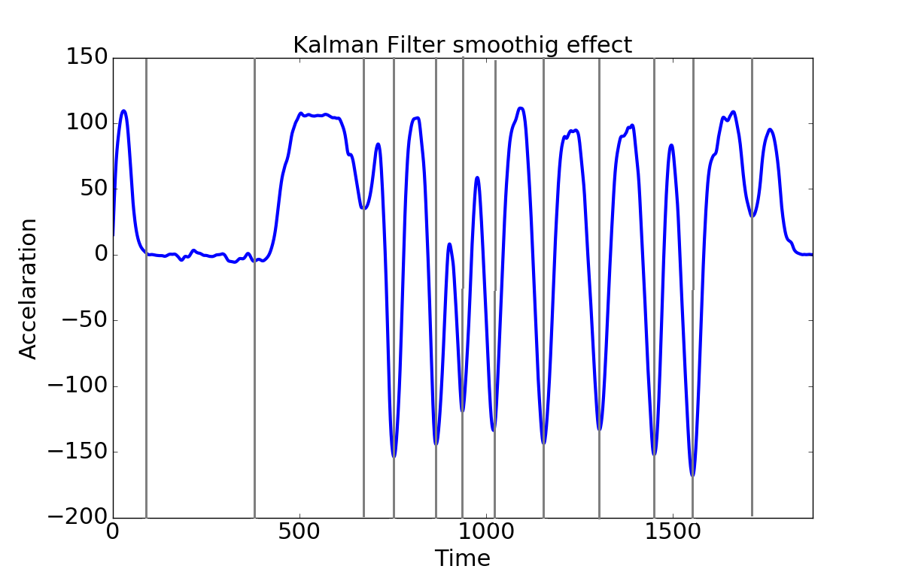
Step 2: Finding each repeats
WORKFLOW
Noiseless

Slide 11







Step 3: Finding correct repeats
WORKFLOW
Noiseless
Repeats

Slide 12
Step 3: Finding correct repeats
WORKFLOW
Noiseless
Repeats

Slide 13



Step 3: Finding correct repeats
WORKFLOW
Noiseless
Repeats

Slide 14


Step 4: Oracle pattern
WORKFLOW
Noiseless
Repeats
Correct form

Slide 15
Step 5: region of variance
WORKFLOW
Noiseless
Repeats
Correct form
Oracle pattern

Slide 16
Detecting mistakes
WORKFLOW
Noiseless
Repeats
Correct form
Oracle pattern
Variance

Slide 17
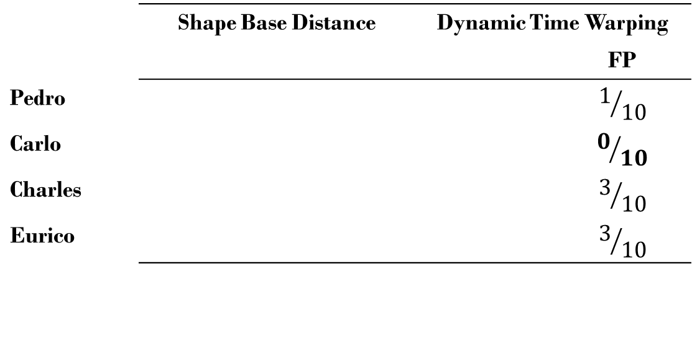
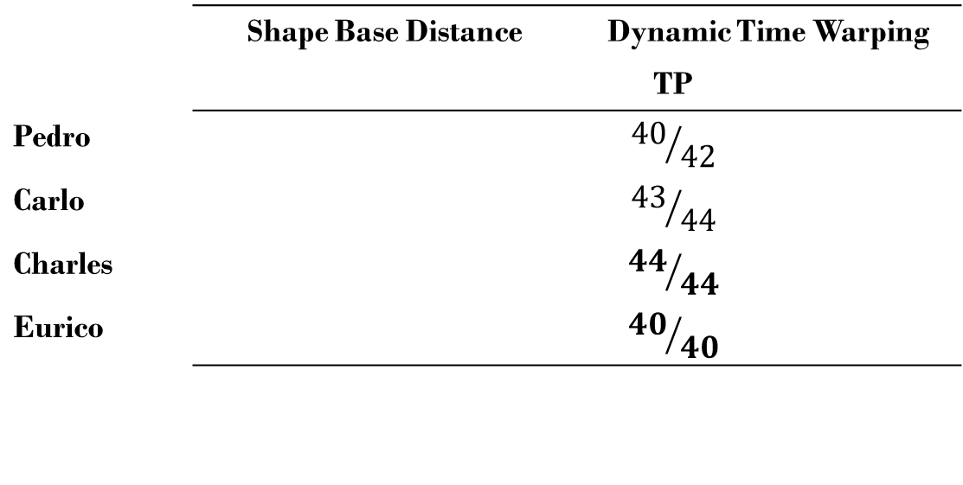
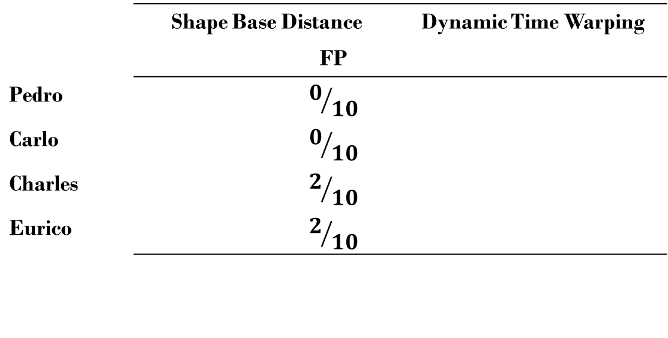
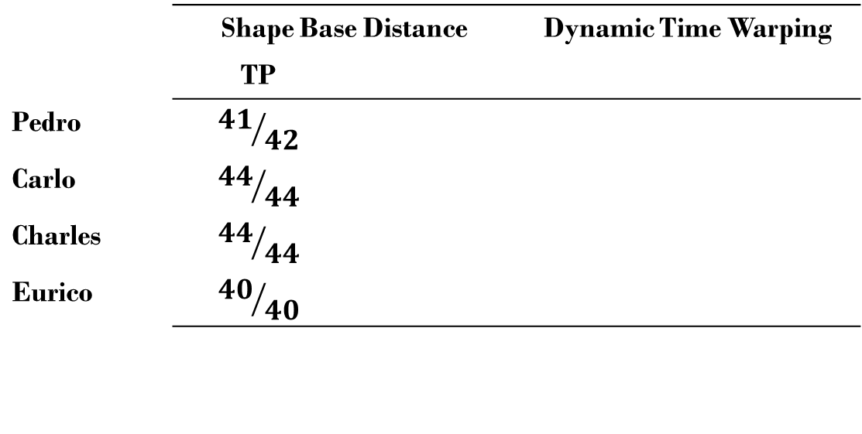
Experiment
4 participants
10 correct repeats
4 sets of incorrect repeats
2 algorithms for deriving oracle pattern
 | Shape Base Distance |  | Dynamic Time Warping
 |  |  |  | FP
Pedro |  |  |  | $$1/{10}$$
Carlo |  |  |  | $$0/{10}$$
Charles |  |  |  | $$3/{10}$$
Eurico |  |  |  | $$3/{10}$$
 | Shape Base Distance |  | Dynamic Time Warping
 |  | FP
Pedro |  | $$0/{10}$$
Carlo |  | $$0/{10}$$
Charles |  | $$2/{10}$$
Eurico |  | $$2/{10}$$
 | Shape Base Distance |  | Dynamic Time Warping
 |  |  | TP
Pedro |  |  | $${40}/{42}$$
Carlo |  |  | $${43}/{44}$$
Charles |  |  | $${44}/{44}$$
Eurico |  |  | $${40}/{40}$$
 | Shape Base Distance |  | Dynamic Time Warping
 | TP
Pedro | $${41}/{42}$$
Carlo | $${44}/{44}$$
Charles | $${44}/{44}$$
Eurico | $${40}/{40}$$

Slide 18
Conclusion
The first unsupervised algorithm to find incorrect performances from correct ones.
Unlike previous methods where they tried to learn and differentiate the incorrect performance
K-shape performs slightly better than dynamic time warping.

Slide 19
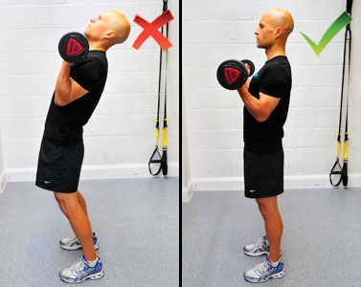
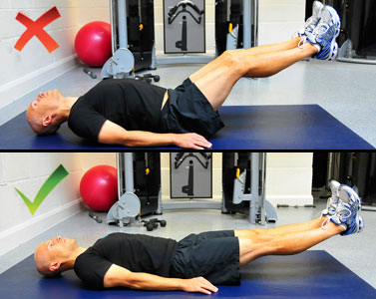
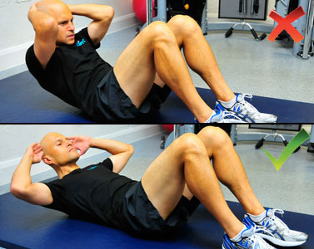
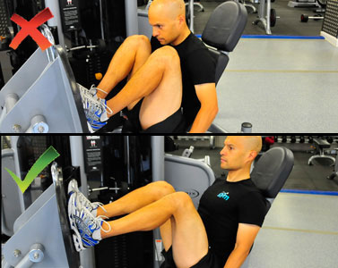
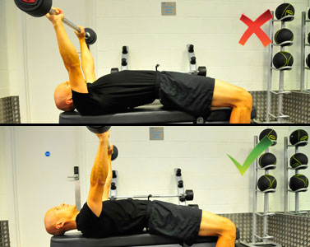
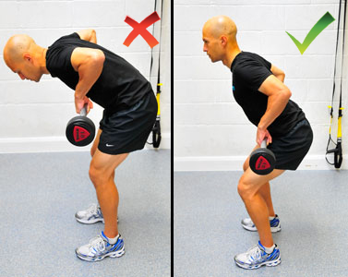
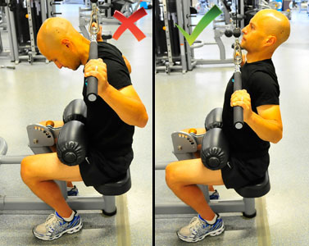
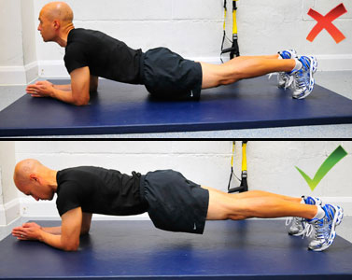
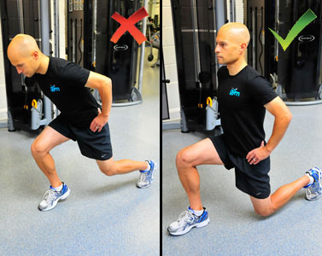
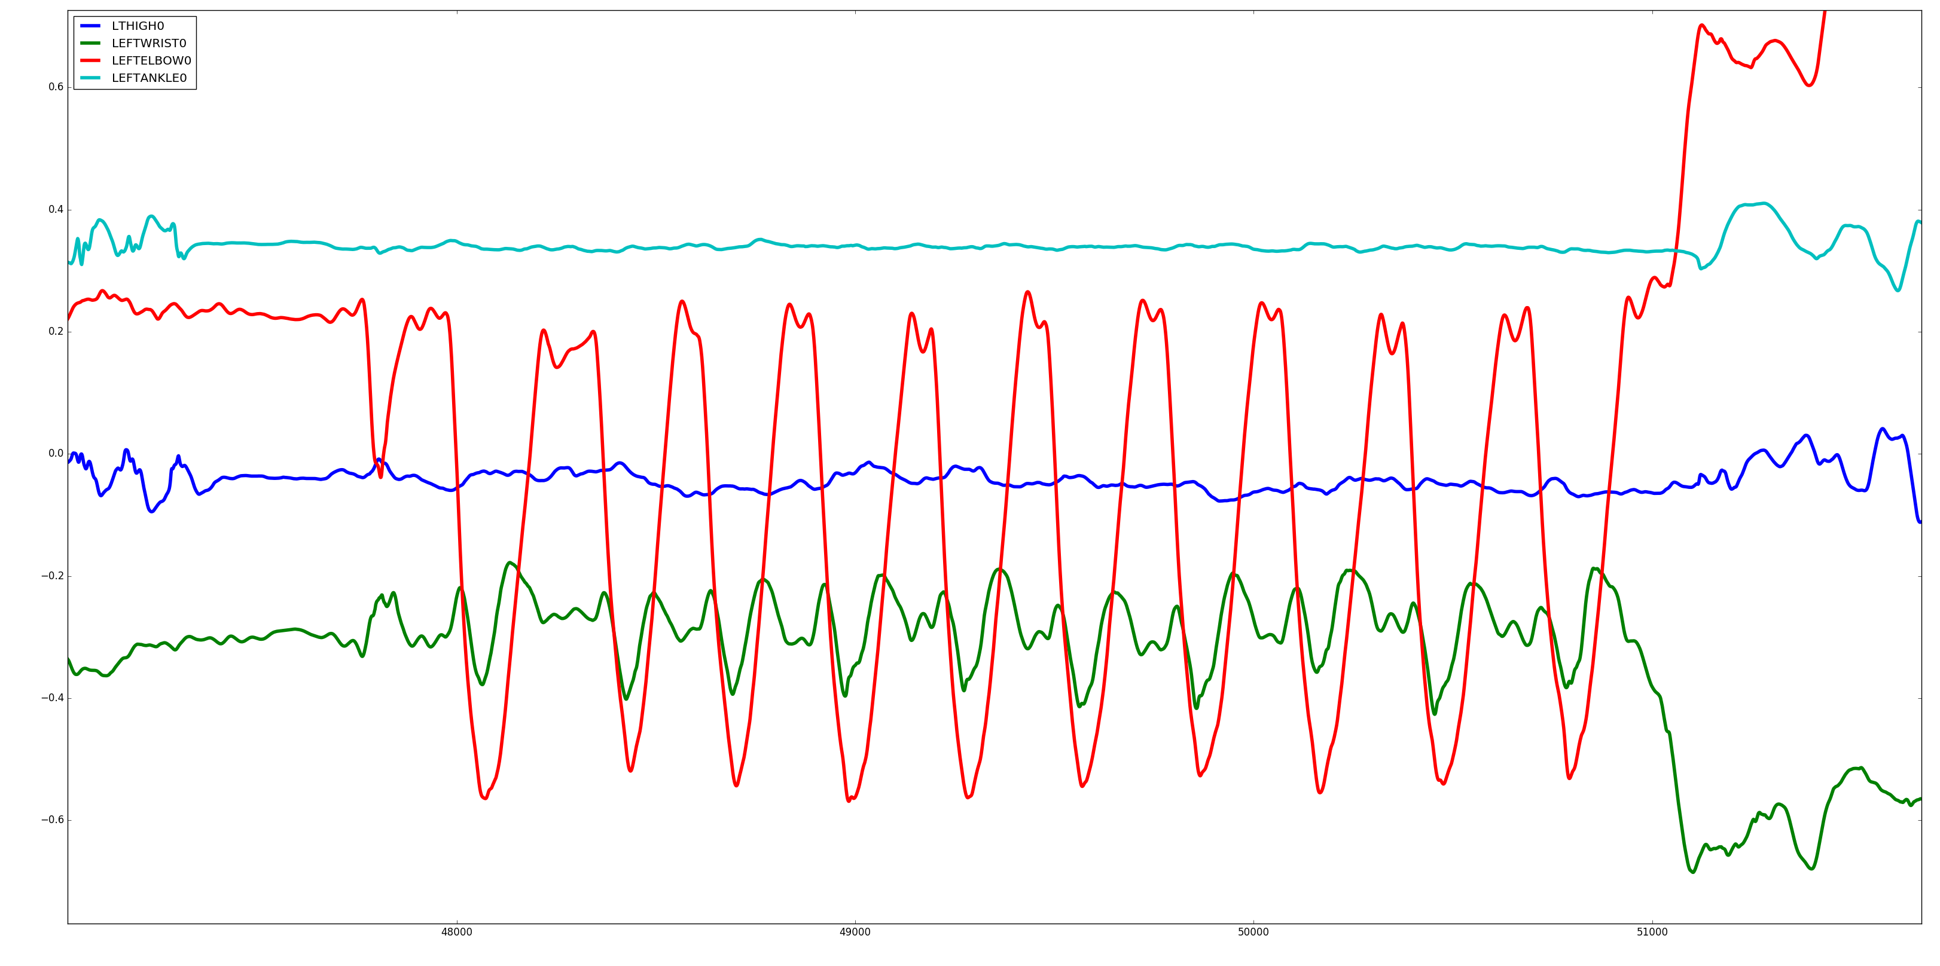
Road to Future
Removing assumptions
Detecting the exercise
Detecting and analysing each repeat
Designing a system that can interact with the weightlifters

Slide 20
Road to Future
Removing assumptions
Detecting the exercise
Detecting and analysing each repeat
Designing a system that can interact with the weightlifters

Slide 21
Thank You!

Slide 22
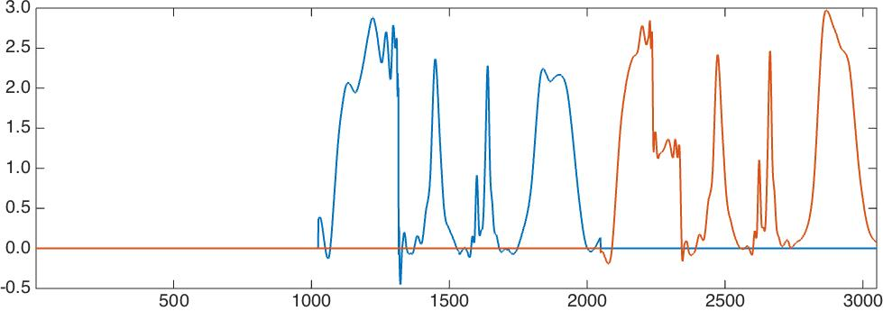
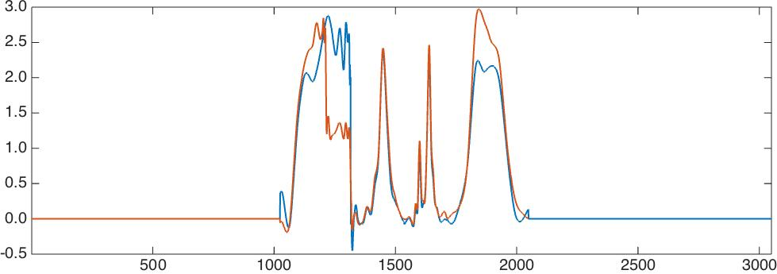
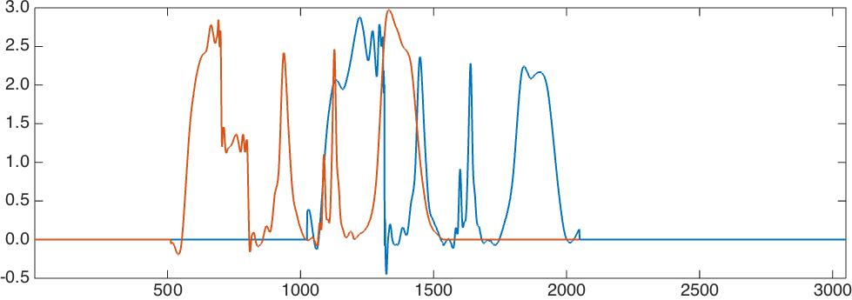
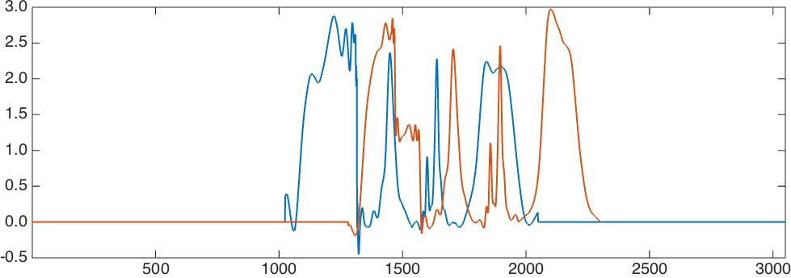
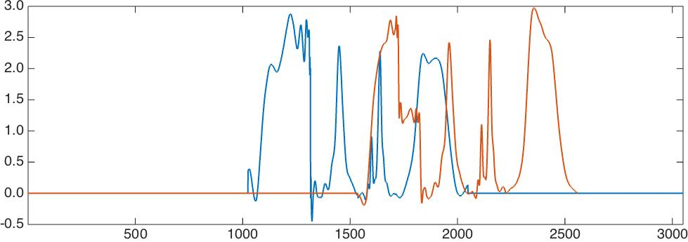
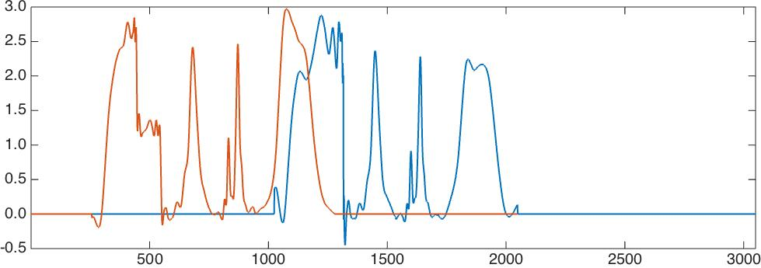
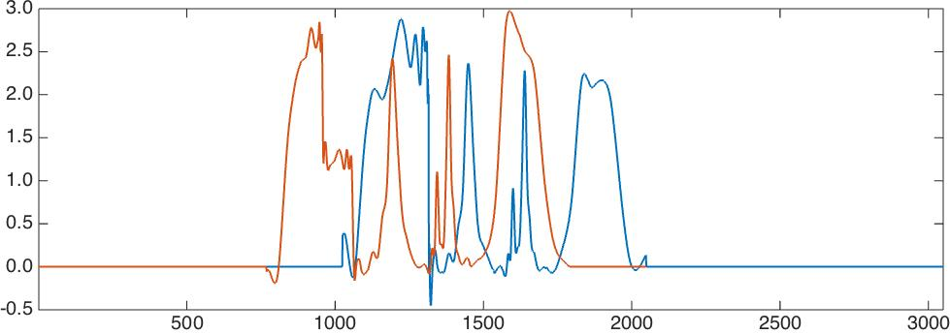
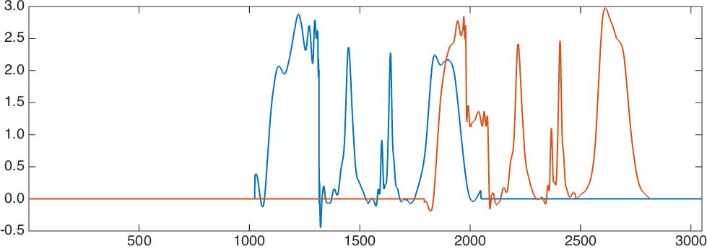
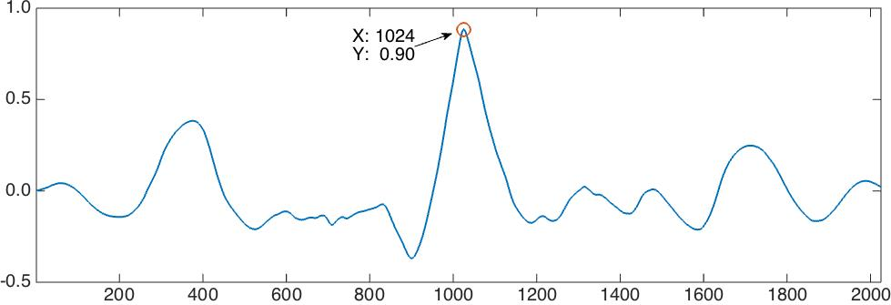
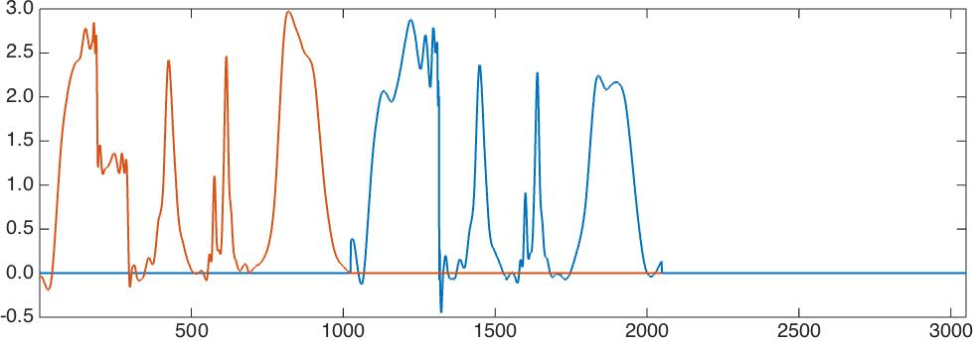
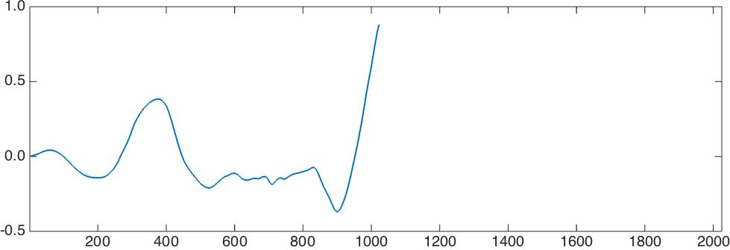
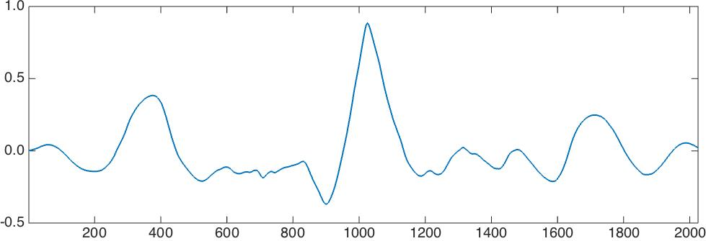
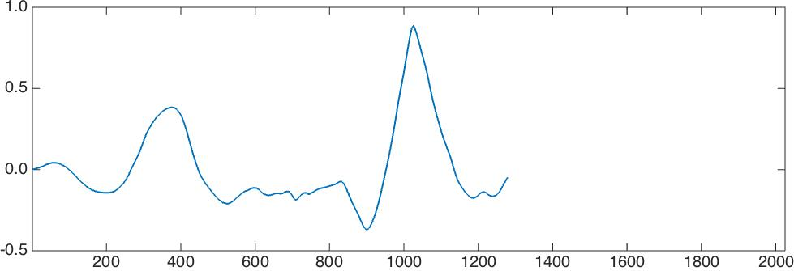
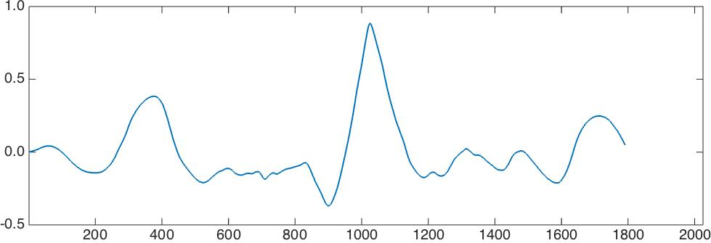
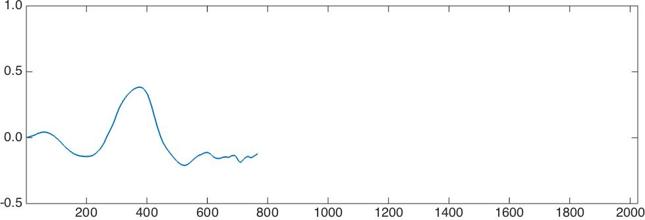
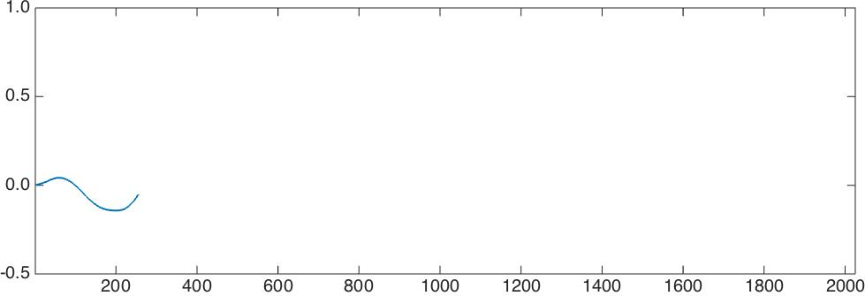
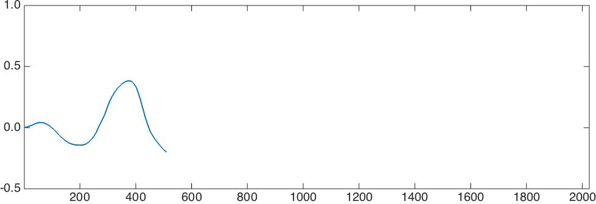
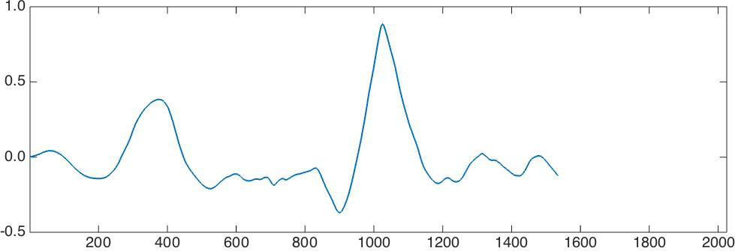
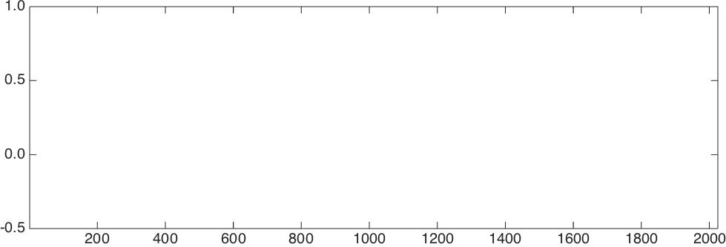
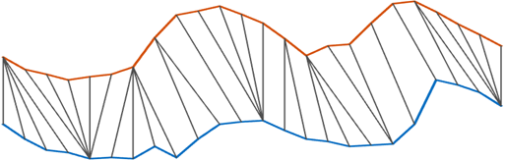
Clustering and prototyping
K-shape: statistical (correlational base clustering)
DTW (Warping measure clustering)

